Slide 1

TEAM PRESENTATION LUNG SEGMENTATION TASK
Sidharth Mehra: sidharth.mehra@ucdconnect.ie Ian McBride: ian.mcbride@ucdconnect.ie Pengcheng Ren: pengcheng.ren@ucdconnect.ie Tianxia Song: tianxia.song@ucdconnect.ie
Helena Bartels: helena.bartels@ucdconnect.ie
Sicheng Zhao: sicheng.zhao@ucdconnect.ie

Slide 2





OUTLINE
Introduction
Methods
Results
Discussion
Future improvements

Slide 3
INTRODUCTION
Task assignment:
- segmentation task
- human lungs
- chest X-rays
- open source data set

Slide 4

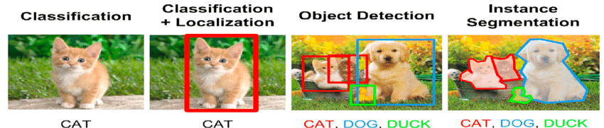
INTRODUCTION
Task assignment:
- segmentation task

Slide 5

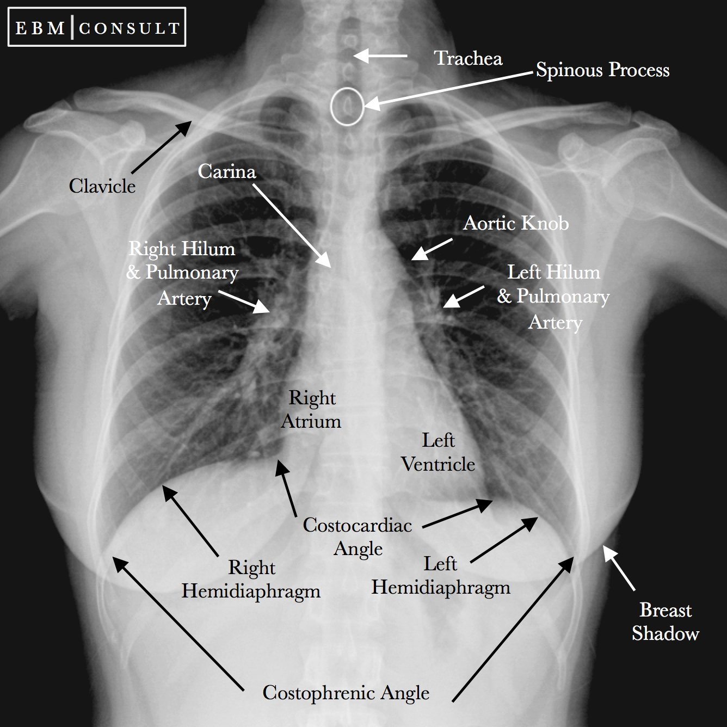
INTRODUCTION
Task assignment:
- segmentation task
- human lungs
- chest X-rays
- open source data set

Slide 6
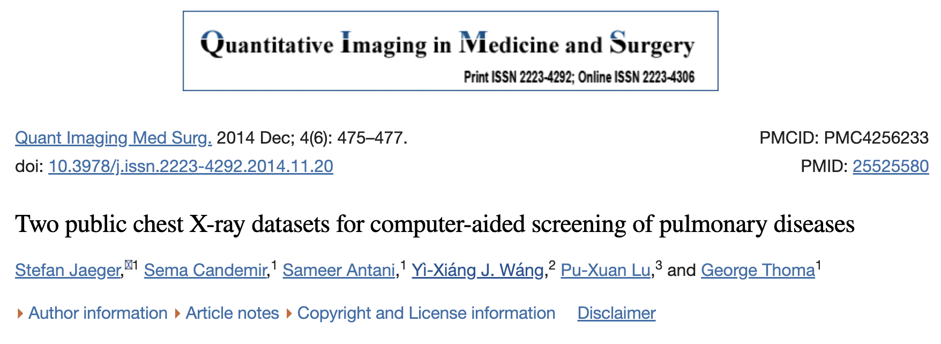
INTRODUCTION
Task assignment:
- segmentation task
- human lungs
- chest X-rays
- open source data set
Montgomery County chest X-ray set
TB screening programme
N = 138 frontal chest X-rays
N = 80 normal cases
N = 58 manifestations of TB
Shenzhen chest X-ray set
Outpatient screening programme
N = 662 frontal chest X-rays
N = 326 normal cases
N = 336 manifestations of TB

Slide 7
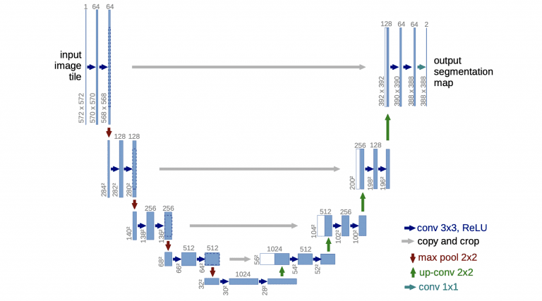

METHODS
Architecture
U-Net
Medical Imagery Segmentation
An encoder
A decoder
Skip connections

Slide 8
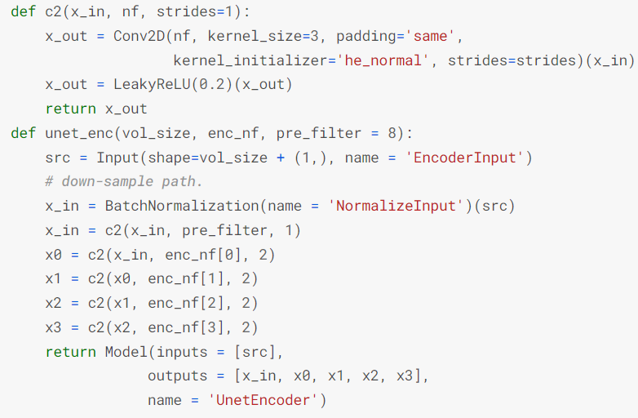
METHODS
Defining a model
3 Iterative blocks
Convolution operation
Takes an input
Applies convolutional operations
Encoder block
Encoder function is defined in convolutional block
Elements quickly downsized
Decoder block
3 arguments: receiving inputs, inputs from skip connections and number of filters
Up sampled
Return final output value

Slide 9
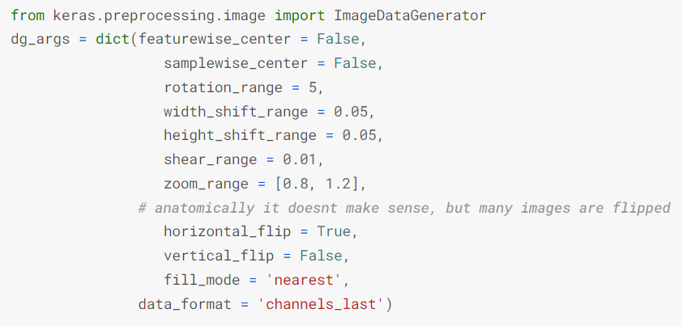
METHODS
Training
Data Split
80% of Montgomery dataset – training
20% of Montgomery dataset – validation
Trained model then applied to 100% of RSNA images
Augmentation
Horizontal flip
Rotation
Shift
Shear
Zoom

Slide 10
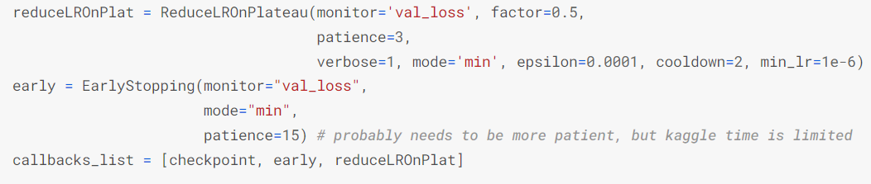
METHODS
Loss
Binary Cross Entropy
As classification task
Optimiser
Adam
Hyperparameters
Scheduler: learning rate reduction – patience: 3
Max Epochs: 25
Early stop trigger: validation loss not decreased in 15 epochs

Slide 11
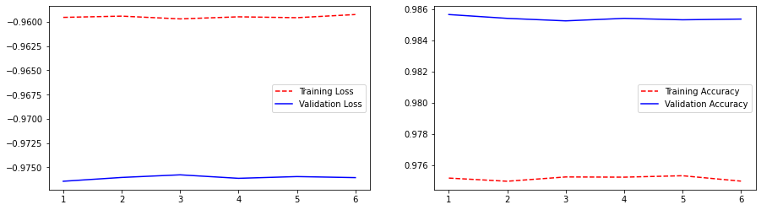

Result Analysis
Training process
There are 32 layers in total here, of which the first 25 rows use a pre-trained model, so the training does not fluctuate much.
Overall, the results are good and there is no significant overfitting.

Slide 12
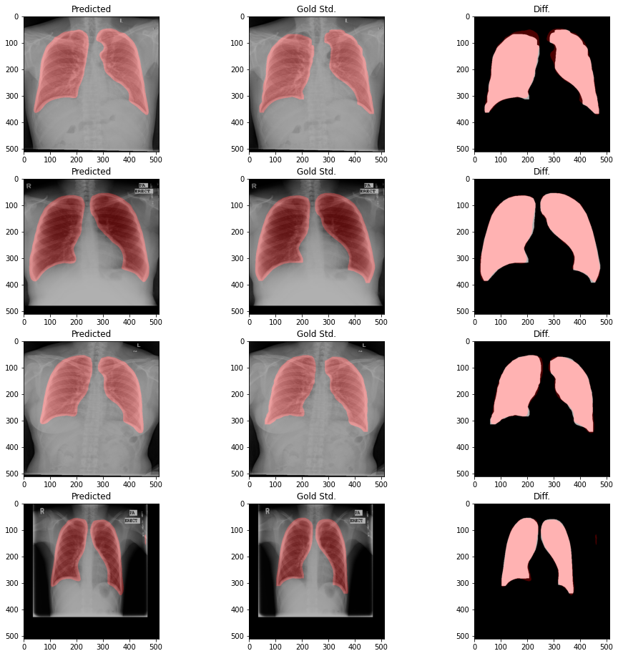
Testing Result
The test set used MIOU as the evaluation index and obtained a score of 0.95308775, which is an excellent performance. And it can be seen that there is no sign of overfitting.

Slide 13
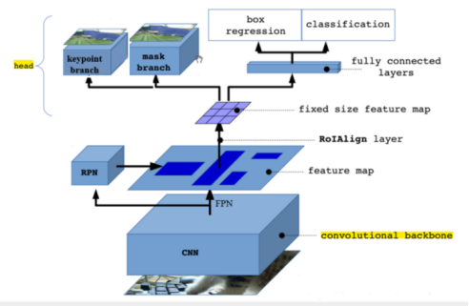
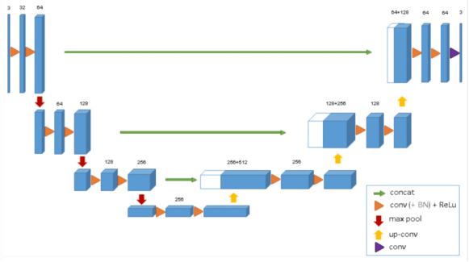
Discussion
https://antkillerfarm.github.io/segmentation/2020/07/27/Segmentation_3.html
https://antkillerfarm.github.io/segmentation/2020/07/27/Segmentation_3.html

Slide 14
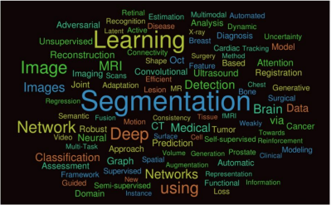
Discussion
An important reason that medical image segmentation has not been successfully solved is the complexity and diversity of medical images.

Slide 15
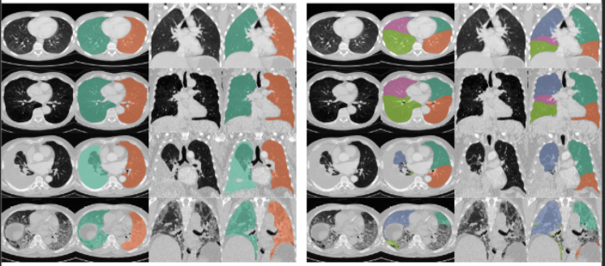
Future and Development
Improve medical image segmentation performance:
Develop models that can utilize multimodal patient data.

Slide 16
Future and Development
Issues Facing:
(1) Lack of high-quality data.
(2) Problems such as inconsistent offset fields and uneven grayscale.
(3) Failure to reflect comprehensive and integrated information features.

Slide 17
Future and Development
Direction of development:
(1) Expand image data by data augmentation; combine pre-training of large datasets and fine-tuning of target datasets using migration learning methods; use weakly supervised learning to effectively combine the advantages of unsupervised pre-training and supervised learning;
(2) Batch normalization, regularization, and Dropout can be used to improve problems such as gray scale unevenness;
(3) Using the feature of complementary information between different images to fuse multimodal medical images, thus improving the accuracy of analysis.

